Slide 1
GraphQL
2/18/2020

Slide 2
Before we start!!
First and foremost, it’s a abstraction.
You can do everything under the sun without graphql, but having graphQL saves you time and effort.
It also gives you a thinking model which enables better collaboration with other developers.
Finally – GraphQL users choose graphql because of its numerous benefits, but stay because it makes it easier to build applications. There are other benefits, but development experience seems to be the primary reason of its stickiness.
There are applications where GraphQL is not the correct tool for the job.

Slide 3
What’s in the Name?
Graph: Think of application data as nodes that are connected to each other.
Customer: Tyson
Customer: Honda
Order: June 2018
Order: July 2018
Product: S900
Product: S800
Document:
Invoice
Document: Cleaning Guide
Document:
SLA Agreement
Image

Slide 4
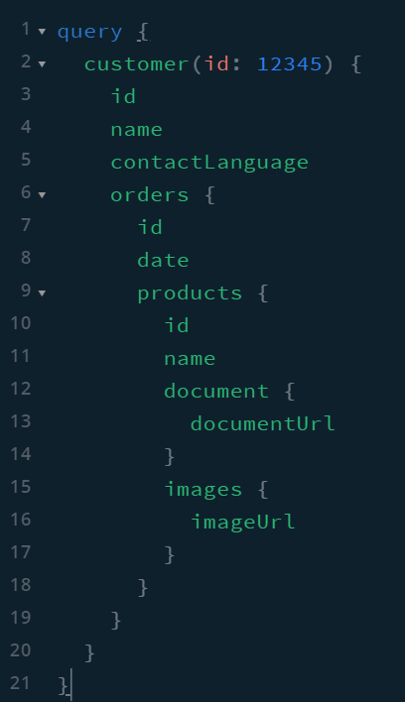
What’s in the Name?
QL: Query Language
Customer: Tyson
Customer: Honda
Order: June 2018
Order: July 2018
Product: S900
Product: S800
Document:
Invoice
Document: Cleaning Guide
Document:
SLA Agreement
Image

Slide 5
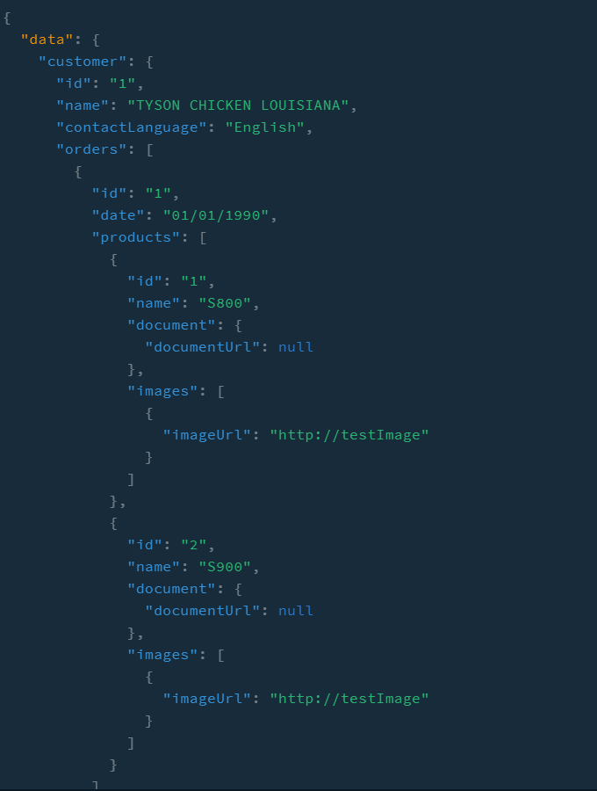
RESULT
Image

Slide 6
GraphQL lets you start at Any Node
Graphql lets you configure your API such that you can start at any node, and get other related information.
Eg: Start at a Product node and get all orders that include this specific product.

Slide 7
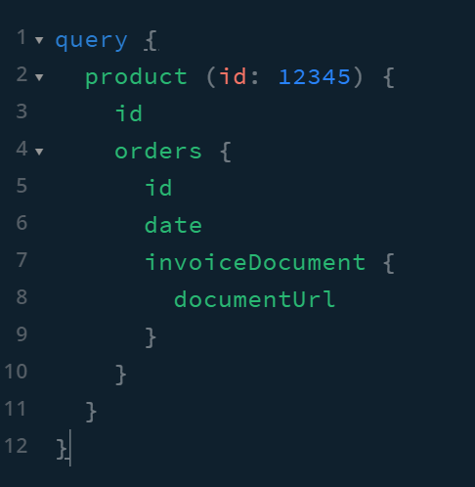
GraphQL lets you start at Any Node
Customer: Tyson
Customer: Honda
Order: June 2018
Order: July 2018
Product: S900
Product: S800
Document:
Invoice
Document: Cleaning Guide
Document:
SLA Agreement
Image

Slide 8
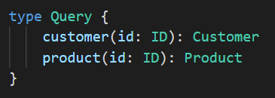
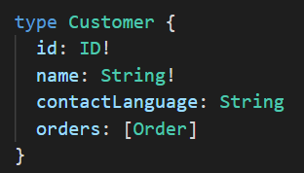
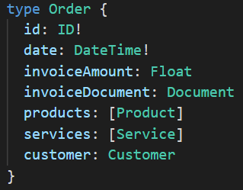
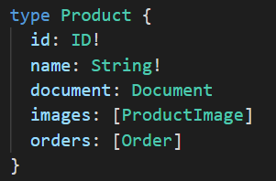
Components of GraphQL API
Schema
Schema defines the data your api returns.
Declare what nodes can be queried
Declare what values exist on each node, and their types
Resolvers
Query / Mutation / Subscription

Slide 9
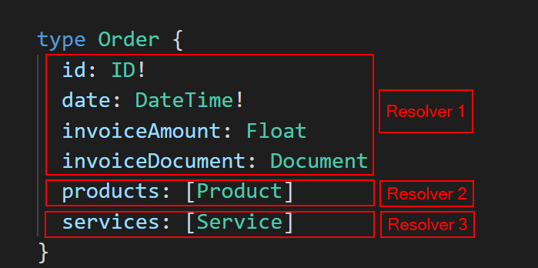
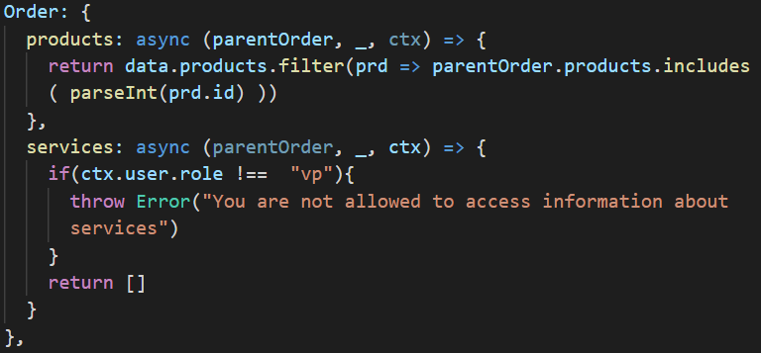
Components of GraphQL API
Schema
Resolvers
A function that knows how to obtain data
GraphQL allows the flexibility to define resolver on a data type or individual fields of a data type.
GraphQL runtime does the plumbing required. Application developers just write functions
GraphQL runtime only runs resolvers if necessary
Permissions can be applied on each resolver function
Query / Mutation / Subscription

Slide 10
Components of GraphQL API
Schema
Resolvers
Query / Mutation / Subscription
Query: Request for specific data
Mutation: Edit/Create data
Subscriptions: Real Time data
Use Query language for all three.

Slide 11
GraphQL enables efficient data loading
Get only what you ask for
Only required amount of data is transferred through the network
Only required data is pulled from sources in the backend
Only one request to the backend no matter how you traverse the data graph
Additionally, multiple queries can be combined into one request
As a result of the architecture:
Once API has been designed, backend doesn’t have to change based on frontend’s needs.
This also enables much faster iteration on the frontend since you do not have to write new api endpoints or make changes to the api.
Speed to features

Slide 12
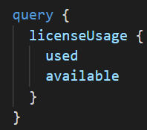
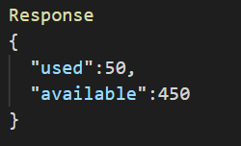
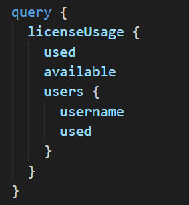
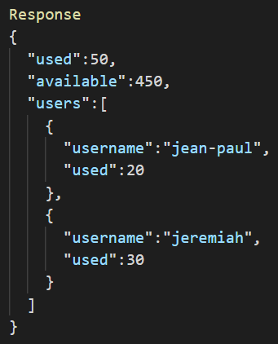
GraphQL enables efficient data loading
Example from GraphQL API
API to get just license Usage
API to get just detailed license Usage

Slide 13
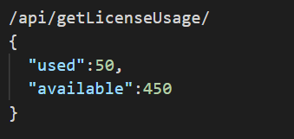
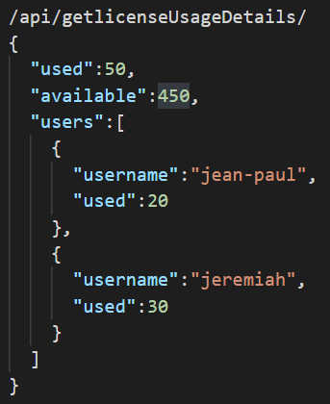
GraphQL enables efficient data loading
Compare with Example from Simulation Portal
API to get just license Usage
API to get just detailed license Usage

Slide 14
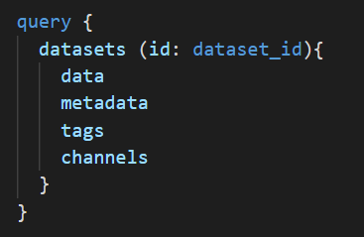
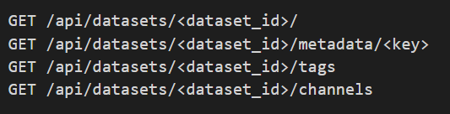
GraphQL enables efficient data loading
Compare with Example from Sensing Portal
vs
Four End points to get various info in REST
In GraphQL, you ask for what you need

Slide 15
GraphQL enables Fine Grain Permissions Checks
Because we can write resolver for each node, it is possible to perform permission check on every node.
If the user is not a VP, don’t return services fields

Slide 16
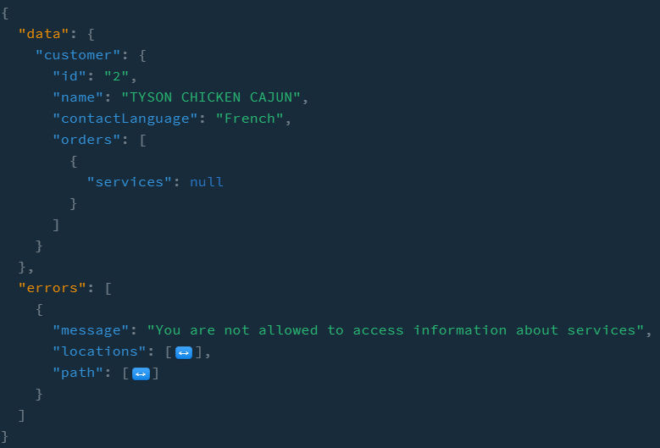
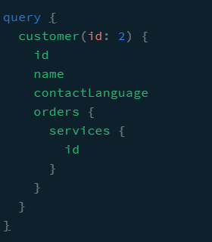
GraphQL enables Fine Grain Error Messages
Because of permissions check, we also get fine grain error messages.
Data that can be fetched is returned along with error message.

Slide 17
GraphQL enables more efficient caching
With alternate technologies like REST, resource is cached based on URL.
This meant that if the same resource was accessed by two different endpoints, they were both saved in the cache as separate items
With GraphQL, each Node is cached which creates efficiencies in caching
Disadvantage:
Node level caching is generally more complex to implement than url level caching
Luckily the community has already developed lots of libraries for caching.

Slide 18
GraphQL enables writing less code
Data plumbing is taken care of by GraphQL runtime.
Do not need any extra code for arbitrary ways of traversing the graph

Slide 19

GraphQL enables easy ways to mix different data sources
Data can be accessed from various different sources. GraphQL makes it very easy to wire up different sources together.
Tridion for Documents
Images Library for Images
CXP
Dynamics/ oracle for Account/ order Data
Calclab for calculators
Mongo for User Sessions

Slide 20
Why Industry Leaders are using GraphQL
Capital One
Uses GraphQL as a way of wiring up various sources of data in their data analytics team.
GitLab
Planning on moving completely to GraphQL based data API because of flexibility it provides
Expedia / AirBnB
Using Graphql to power all of their FrontEnds (website, app, client specific sites)
Intuit
Using GraphQL to connect all of their micro services together
Facebook
GraphQL apis power their news feed which changes over time

Slide 21
Why did we decide to use GraphQL with CXP?
Lots of data sources need to be wired up together
CXP needs will continue evolving. This enables us to not have to change our backend, even as frontend evolves
Faster development time because of self documenting API

Slide 22
Real Demo + Questions?
Demo Topics
Schema Review
Resolver Review
Quick chat about permissions, authorization etc.

Slide 23
Extra Slides Below

Slide 24
Benefit of thinking of app data as a graph
REST is the current best alternative. To build out our two requirements here are the rest endpoints. Compare this with GraphQL in later slides
REST Endpoints
/customers | Returns list of customers
/customers/id | Returns info about customers
/customers/id/orders | Returns orders for the customer
/orders/id/documents | Returns documents related to a specific order
/orders/id/images | Returns images related to a specific order
/products/id/images | Returns images related to a specific product
/products/id/orders | Returns orders for product with a certain id
/orders/id/documents | Returns documents for a specific order

Slide 25
Challenges with REST
Have to know requirements ahead of time.
As a project evolves, new APIs get added to fulfill specific data requirements of evolving application.
Clients and Front end developers do not have a automated way to know what’s possible and how to query it.
Always dealing with over-fetching or under-fetching

